Slide 1
Learn Math Through VR: Requirements
BY Dhruv Patel, Priyam Patel, Mohammed Hassan, Mariam Zikaria

Slide 2

About Our Project
Grade school student learning math using VR.
Target audience: grade school, middle schools, and potentially high schools.

Slide 3
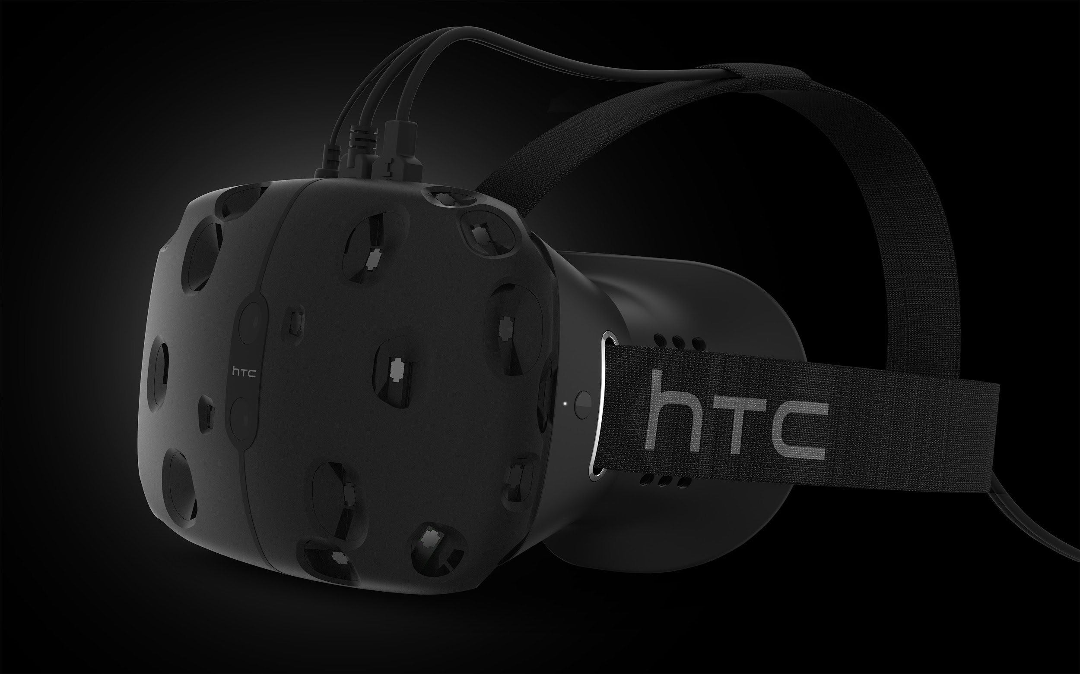
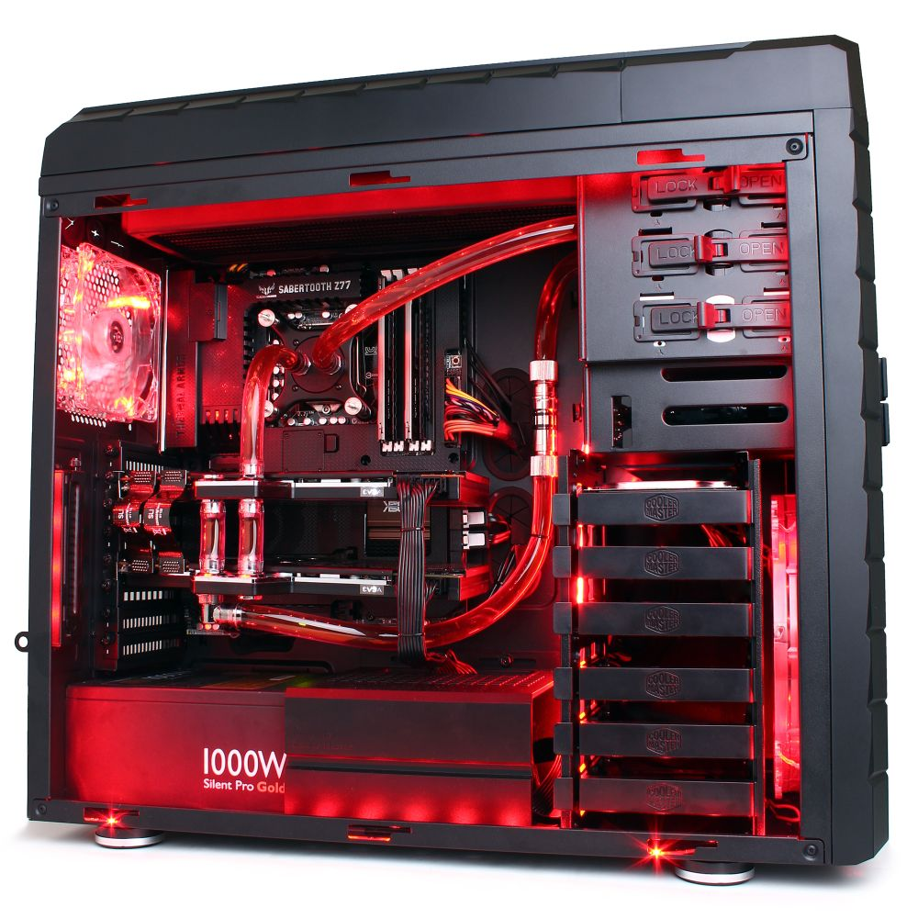
Hardware Requirement
HTC Vive
Multiple computers
High graphic cards

Slide 4
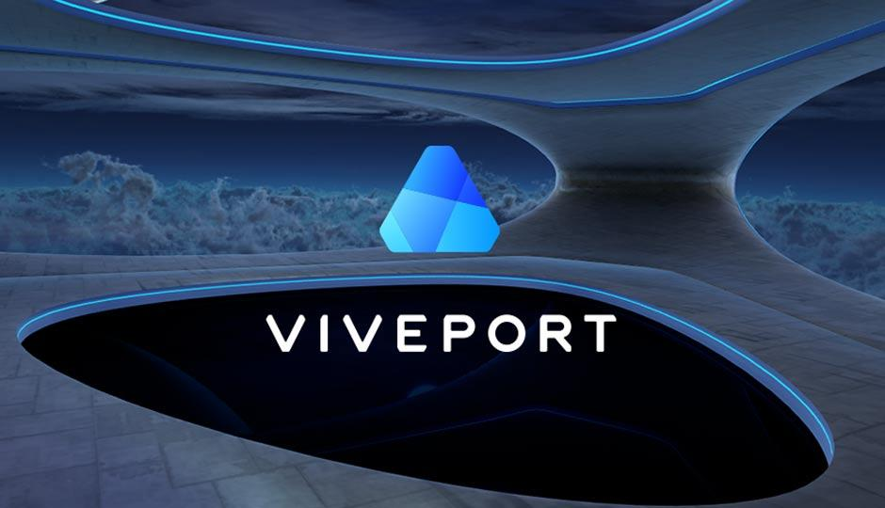
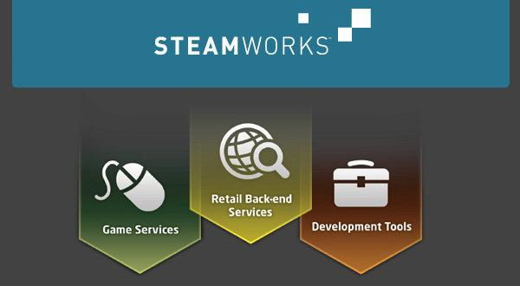
SOftware Requirement
Viveport
Browse and download VR experiences for Vive
Steam VR
Need to register as a Steamworks developer

Slide 5
System Requirements
GPU
Nvidia GeForce GTX 970
AMD Radeon R9 290
CPU
Intel i5-4590
AMD FX 8350
RAM
4 GB or more
OPERATING SYSTEM
Windows 7 SP1
Windows 8.1
Notes:
http://www.trustedreviews.com/news/can-i-run-the-htc-vive

Slide 6
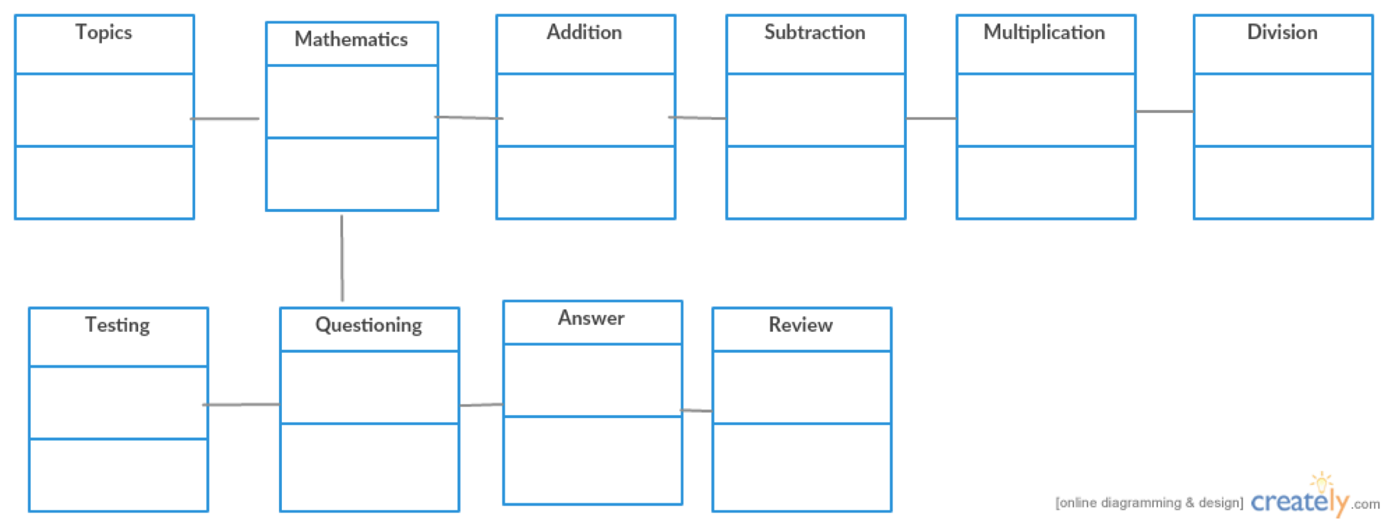
Data Requirement

Slide 7
Training Requirements
Tutorial
How to use HTC Vive
How to run the program
Gestures and sensors
Moving blocks
Answering questions/Reviewing answers
Movement and verification
Sensor calibration

Slide 8
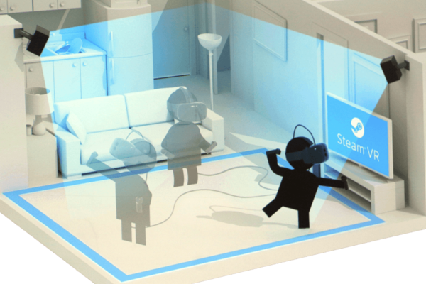
Room-Scale requirements
Set up for Room-Scale
Look and Feel Requirements
Need to have enough room space for the user to interact freely
Can alter between standing and seated VR experience

Slide 9

How will this program be suitable for children?
Look and Feel Requirements
Color
Shapes
Large text
Simplicity

Slide 10
Learning requirements
Lecture
Testing different block movements to simulate mathematical operations (experimentation)
Reading question
Answering question
Reviewing answer
Practice/Increasing Difficulty

Slide 11
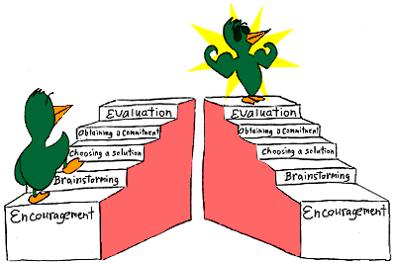

Slide 12
Security Requirement
A teacher can only be able to access students information
Student will have username and password to access progress report

Slide 13
Budget Requirement
HTC Vive - Headset => $799
Project Documentation => $700-$3400
Application Development => $50,000-$200,000
Graphic Designs => $50,000-$100,000
Post production maintenance and system updates => $50/mo fee
Notes:
https://thinkmobiles.com/blog/how-much-vr-application-development-cost/

Slide 14
Timeline
M0 - M3 Requirement Stage
M3 - M6 Implementation
M6 - M9
Release and Update
Consult with the client
Get technical requirements
Come up with a technical plan
Come up with an estimated budget
Plan implementation
Execute implementation
Test features
Consult client
Finalize the cost
Release of the working product
Launch the final version
Perform maintenance and updates
Notes:
http://www.opus-gmbh.com/wp-content/uploads/2016/07/Screenshot1683-1-1024x518.jpg

Slide 15
Any questions?

